Slide 1


List factors affecting Where (spatial) and when (Temporal) bushfires occur.

Slide 2
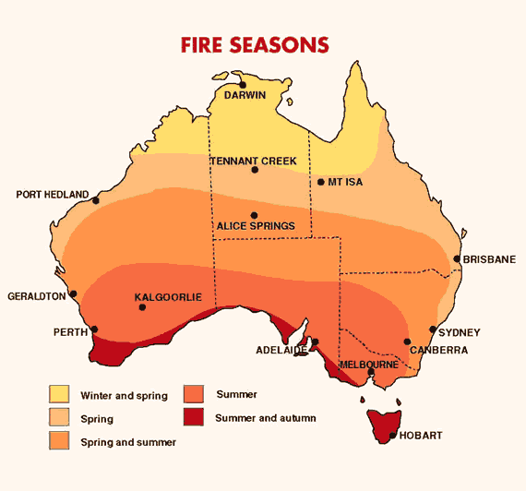

Slide 3
Weather v Climate
Weather
* Weather is the short – term condition of the atmosphere at a given place and time, such as: it is a rainy and cold day.
* Weather is measured by examining and looking at changes in daily temperature, precipitation (rainfall), wind speed and direction, cloud cover, humidity and atmospheric pressure.

Slide 4
Weather v Climate
Climate
* Climate is the long - term, average weather conditions for a location, calculated over a long period of time. This time period is generally 30 years.
* Climate is measured from long – term temperature and precipitation (rainfall) data. It is often expressed as seasonal averages and/or monthly averages.

Slide 5
How would you describe Australia’s Climate?

Slide 6
How would you describe Australia’s Climate?
Australia has a hot and dry climate, relatively low and very unreliable rainfall, and droughts (or at least very dry periods) are common.

Slide 7
Climatic conditions result in bushfires being a common occurring natural disaster in Australia.
Three of the most devastating fires in Australia’s history:
Black Friday, 13 January 1939, 71 people died and almost 1.5 million hectares burned in Southern and North Eastern Victoria
Ash Wednesday, 16 February 1983, 75 people perished, 2,500 homes were destroyed, 335, 000 hectares of land burned and there were huge sheep and cattle losses in Victoria and South Australia
Black Saturday bushfires, 7 February 2009, were a series of bushfires that ignited or were burning across the Australian state of Victoria, 153 people died and approximately 3,500 building were destroyed in Victoria over a

Slide 8
Both Weather and Climate affect bushfires…

Slide 9
Weather
Bushfires tend to occur following periods of low rainfall when fuel loads have dried out.
After comparing spatial distribution patterns of bushfires with the climatic patterns of Australia, a strong correlation exists between areas with low relative humidity, high winds, high temperatures and lack of rain.

Slide 10
Climate
Seasonal variations clearly show an interrelationship between bushfires and climates that experience a hot and dry season, high probability of drought, unreliable rainfall and the possibility of strong winds.

Slide 11
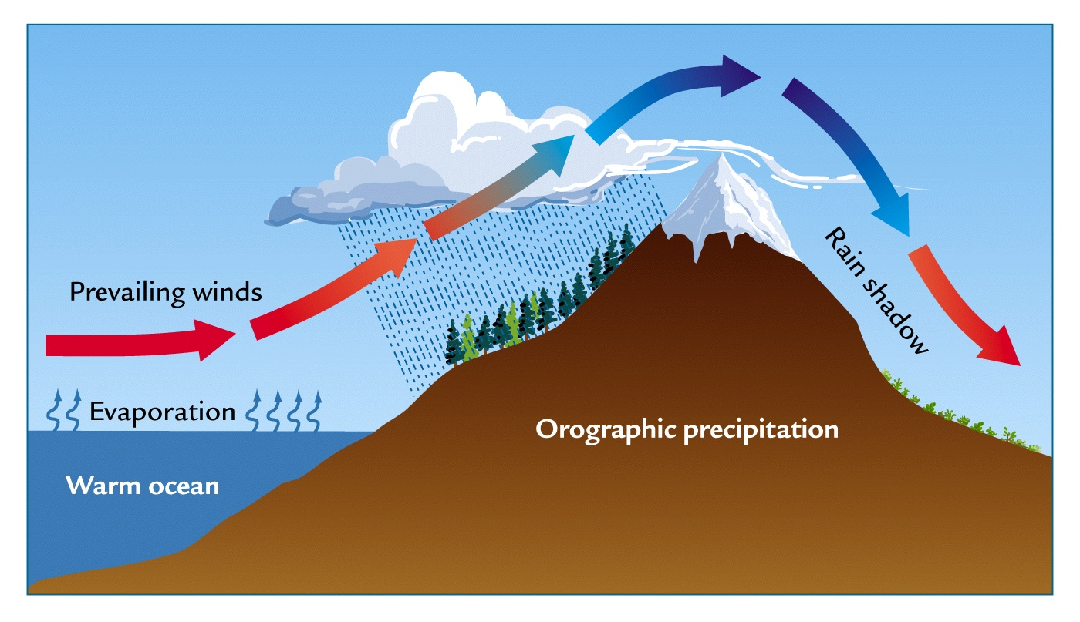
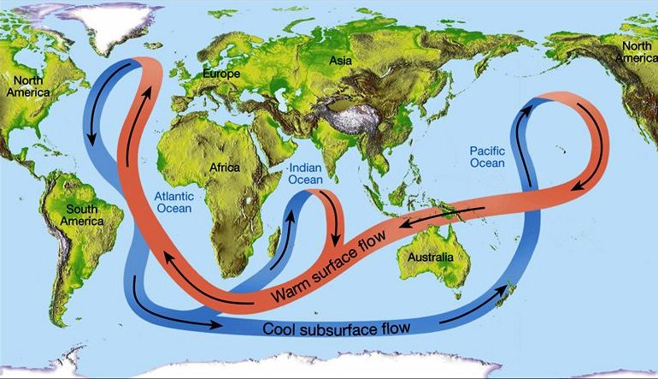
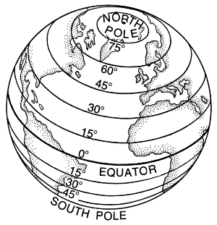
OLDMAP – Factors affecting CLIMATE
O –
L –
D –
M –
A –
P –

Slide 12
OLDMAP – Factors affecting CLIMATE
O – Ocean Currents
L – Latitude
D – Distance from Sea
M – Mountain Barriers
A – Altitude
P – Prevailing Winds

Slide 13
Latitude and Prevailing Winds have a direct affect on the spatial distribution of bushfires in Australia.

Slide 14
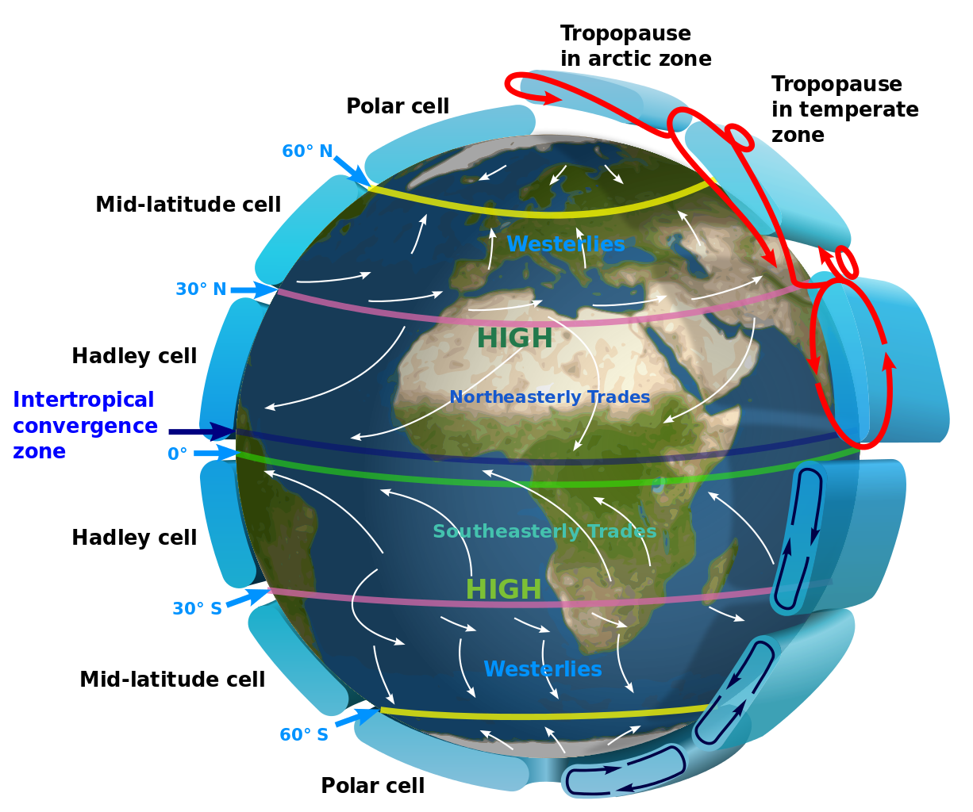
Atmospheric Circulation

Slide 15
Atmospheric Circulation
Atmospheric Circulation refers to the general movement of the air across and above the surface of the Earth.
It is a natural system which developed in responses to the uneven heating of the Earth.
The pressure systems and winds that are created help to redistribute heat away from the Equator towards the Poles.

Slide 16
Atmospheric Circulation
Global air pressure belts and prevailing wind systems are the product of the heat budget, the rotation of the earth and localised effect of landforms.
These wind and pressure systems shift north and south by about 15 degrees of latitude over the course of a year. Causes – tilt of the earth’s axis and effect that this has on overhead position of the sun.

Slide 17
Atmospheric Circulation System
Pressure Belts:
The earth is heated unevenly by the sun.
Warm air rises forming low pressure systems at the surface.
Cold air descends creating high pressure systems.
Belts of pressure form across the earth as a result.
Examples: Polar Highs (found between 60 and 90 degrees north and south), Sub Polar Lows (found between 30 and 60 degrees in either hemisphere) , Sub Tropical Highs (found between 15 and 30 degrees in northern and southern hemisphere), Equatorial Lows (shifts north and south in a zone 15 degrees either side of the Equator)

Slide 18
Key Elements – Atmospheric Circulation
High and Low Pressure Belts
Pressure belts form alternating bands of high and low pressure with winds blowing from high pressure to low pressure cells.
High pressure systems mainly correspond to regions of low precipitation.
Low pressure belts correspond to the rainy regions of the globe.
The heat budget is mainly responsible for the global pressure belts surrounding the earth.

Slide 19
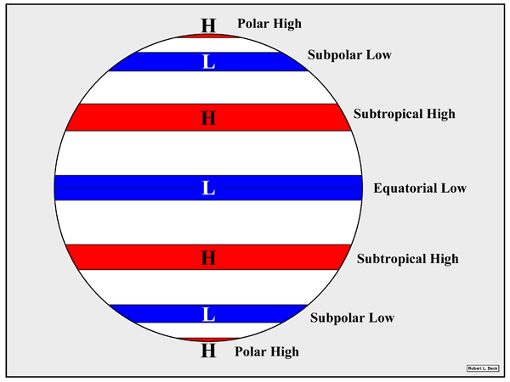

Slide 20
Key Elements – Atmospheric Circulation
Air Movement in Low Pressure Systems
Air in low pressure systems moves away from the earth’s surface. As it does so it becomes cooler and less stable.
Condensation occurs as dew point is reached with precipitation likely to follow.
Air also circulates into low pressure cells. It is clockwise in the southern hemisphere and anti-clockwise in the northern hemisphere.

Slide 21
Key Elements – Atmospheric Circulation
Air Movement in High Pressure Systems
Air in high pressure systems sinks towards the earth’s surface and is heated by compression.
This increases its ability to absorb water vapour and decreases the probability of precipitation.
Fine, dry conditions are common in high pressure zones. It is clockwise in the northern hemisphere and anti-clockwise in the southern hemisphere.

Slide 22
Atmospheric Circulation System
Wind Systems:
Air moves from areas of high pressure to areas of low pressure, creating winds across the surface of the Earth.
Examples: Easterlies, Westerlies, Trade Winds

Slide 23
Atmospheric Circulation System
Circulation Cells:
Warm, rising air and cold, falling air create circulation cells within the troposphere between the pressure belts.
Example: Hadley cells

Slide 24
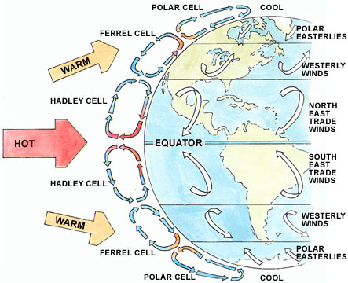

Slide 25

Indian Ocean Dipole

Slide 26

3.3 The Patterns of Bushfires
Read pages 65 – 68
Complete activities 3 – 7 on page 68
Homework – activities 1 -2 due Monday

